Slide 1



AFYN
2026-2027
AFYN.ORG

Slide 2

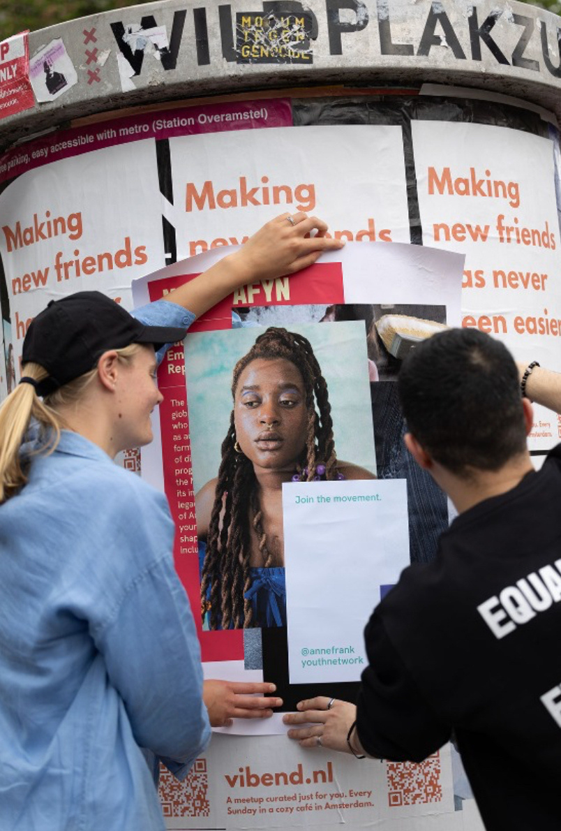

  WHAT IS AFYN?
Inspired by Anne Frank’s diary and life story, our work connects young people, providing us all with the tools to take action and realize our own projects to create meaningful change in our communities. The Anne Frank Youth Network is an initiative developed by the Anne Frank House.

Slide 3

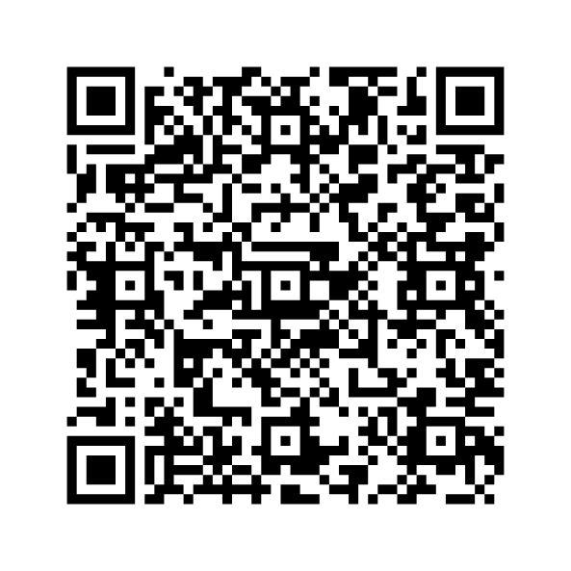


  AFYN IN THE US
AFYN is currently has members in over 15 states across the U.S! We have hosted 3 conferences in South Carolina and are planning to host more in the future across the country! Sign up for our newsletter using the QR code to learn more about upcoming AFYN trainings in your state this school year! You can also follow us on Instagram for updates @us.annefrankyouthnetwork

Slide 4

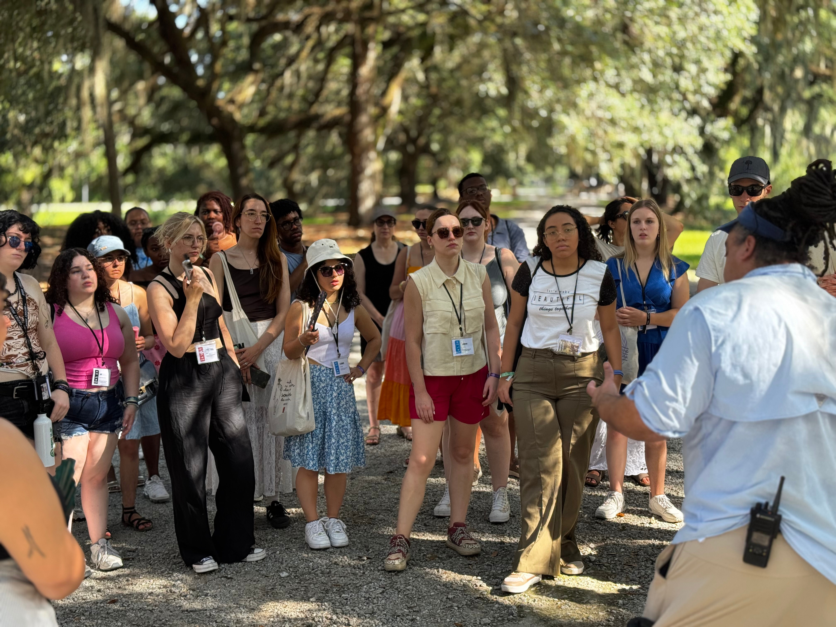

  AFYN AROUND THE WORLD
AFYN operates in 22 countries globally with over 3,000 members! Each summer, we are hoping to offer an International Youth Forum, where young people from across the world can come together to learn about topics related to human rights, discrimination, and antisemitism. The other Anne Frank Centers are located in Berlin Germany, Buenos Aries, Argentina, the UK, and the Anne Frank House in Amsterdam. We also have a very active partner in Brazil!

Slide 5

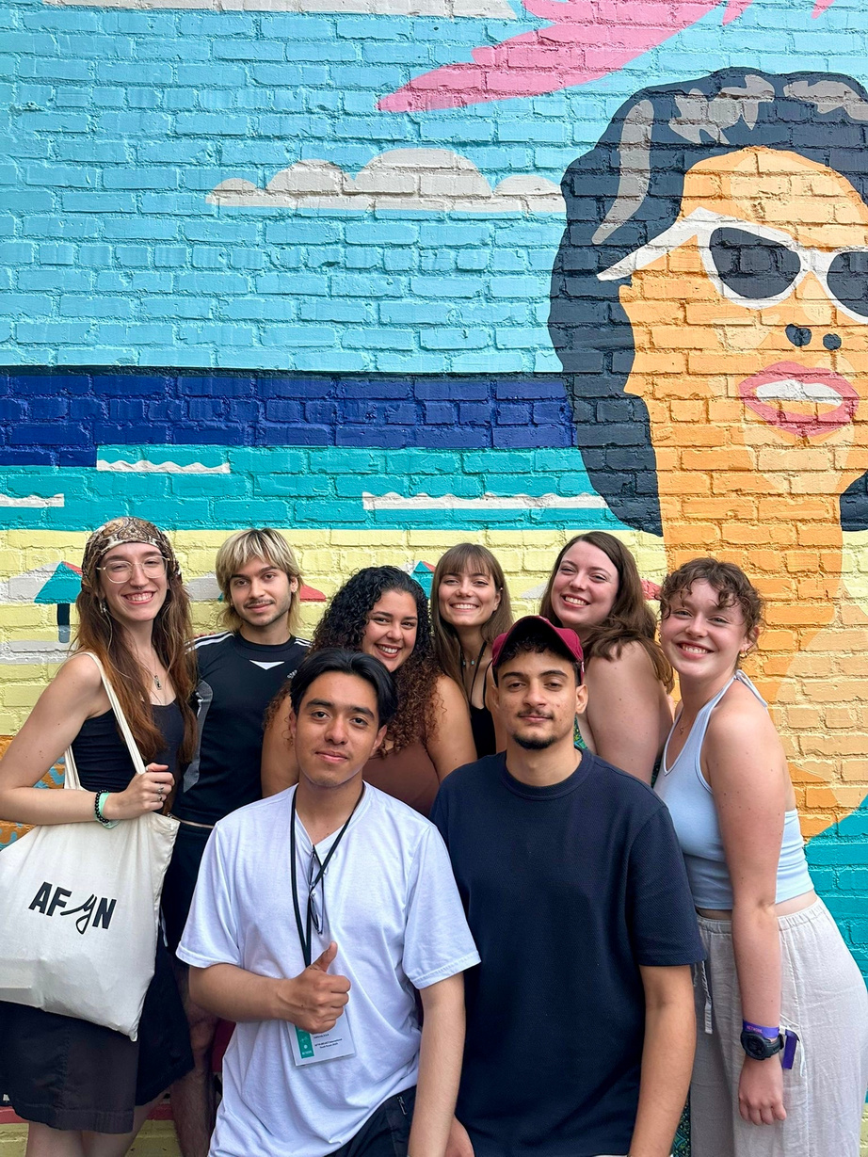

AFYN Domestic conferences!
The U.S. Anne Frank Youth Network will be hosting a domestic conference every summer! Stay tuned for details about the summer 2027 conference!

Slide 6
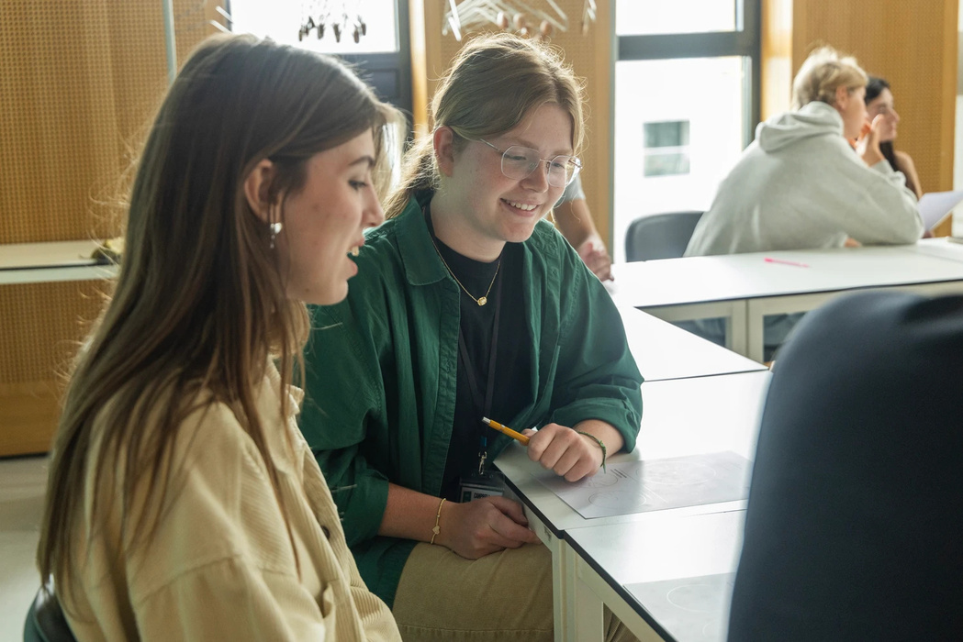
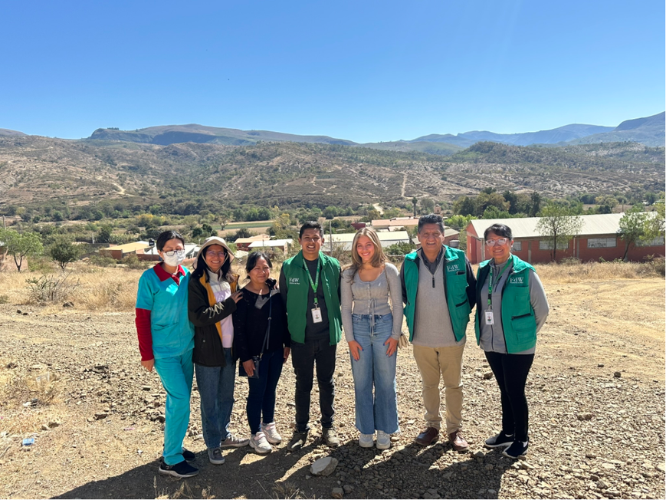
ACTION PROJECTS
In order for all participants of the network to remain active and eligible for conferences and international travel, they must complete an action project each school year.
An action project is a project, workshop, campaign that positively impacts your community. You can create a project at your school, university, or somewhere else in your community where you are active and see a need for change!

Slide 7
  QUESTIONS?

